Slide 1
Safeguarding Section 175/157
Timeline
Part 1 (Sections 1-14): Themes
Audit Opened: Monday 12 January
Audit Closes: Friday 29 May (three half-terms)
Part 2: (Section 15): Data collection
Audit Reopens (Section 15 only): Monday 29 June
Audit Closes: Friday 24 July (one month)
Questions provided: September 2025
Notes:
The audit opened yesterday. Two schools have already completed with detailed action plans.
16 other schools have already started.
The first part of the audit (Sections 1-14) closes at the end of May.
Can you please check that you have received your log on details. If not, please let me know.
The questions for the 2nd part of the audit were sent to schools in September (just like last year)

Slide 2
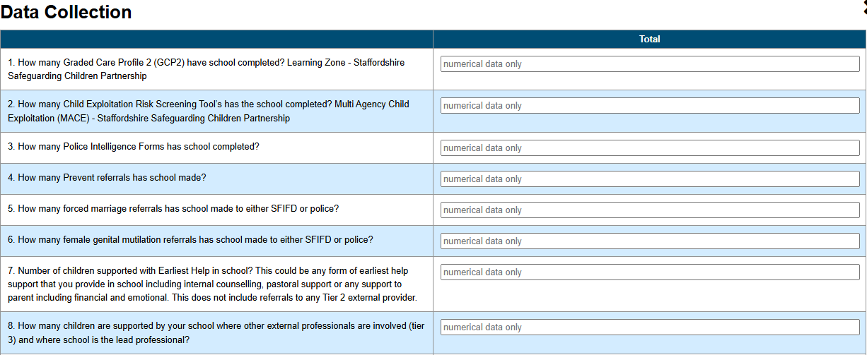
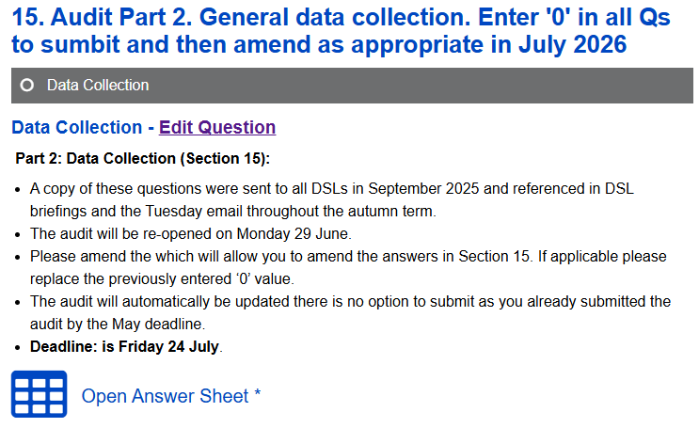
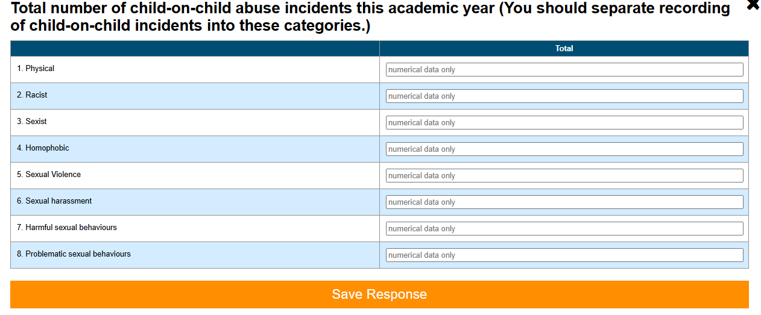
Safeguarding Section 175/157 Audit
Section 15: Data collection
Notes:
Section 15 is for data collection.
It cover the whole of the academic year. Please when you submit the audit before the end of May simply insert ‘ZEROS’ in every section.
When the audit reopens at the end of June you will only be able to amend this section. Change the ‘0’ if appropriate to the number from your safeguarding system and simply press save.

Slide 3
Safeguarding Section 175/157 Audit
Current Position
Notes:
It is worrying as you get older that time just seems to go faster and faster.
And here we are again in January with the launch of this year’s Section 175/157 Safeguarding Audit.
The reasons we undertake this audit are threefold.
Schools: robust self evaluation of safeguarding policy and practice.
SSCP: So that the partnership is assured on an annual basis regarding the strength of safeguarding across the county
ESAS: It informs so much of the teams work for the following year.

Slide 4
Safeguarding Section 175/157 Audit
AIMS
Schools: Provide schools with a robust self-evaluation of policy, practice and compliance.
Staffordshire Safeguarding Children Partnership: ESAS reports to SSCP on an annual basis using the audit’s qualitative and quantitative information, so that the partnership can be assured of schools safeguarding across the county.
ESAS: Identify areas of strength and weakness across the county, phases and districts as well as in individual schools
  Undertake safeguarding reviews in identified schools
  Inform DSL training and briefings
  Communications: Inform Tuesday emails and our 7-minute briefings
  Share with partners i.e., Prevent Board
  Assure SSCB
Notes:
It is worrying as you get older that time just seems to go faster and faster.
And here we are again in January with the launch of this year’s Section 175/157 Safeguarding Audit.
The reasons we undertake this audit are threefold.
Schools: robust self evaluation of safeguarding policy and practice.
SSCP: So that the partnership is assured on an annual basis regarding the strength of safeguarding across the county
ESAS: It informs so much of the teams work for the following year.

Slide 5

Education Safeguarding Advice Service (ESAS)
The Team
Core Offer
Education Safeguarding Leads (ESLs): Viki Hulme and Coleen Worrall
viki.hulme@staffordshire.gov.uk
coleen.worrall1@staffordshire.gov.uk
Education Safeguarding Advisors (ESAs): Caroline Boote and Lucy Wheeldon
Tel: 01785 895836 Email: esas@staffordshire.gov.uk
Head of School Improvement and Education Safeguarding: Charles Daniels
Provide safeguarding advice and information, to all Staffordshire education settings, to enhance safeguarding practice
Empower education settings to make informed decisions.
Remember:
This service is provided to all education settings across the county at NO COST
Notes:
For people that are new and may not not ESAS as well as others.
2 ESLs
2 ESAs
Core Offer
No SLA, no sign up, everything we offer is at no cost

Slide 6
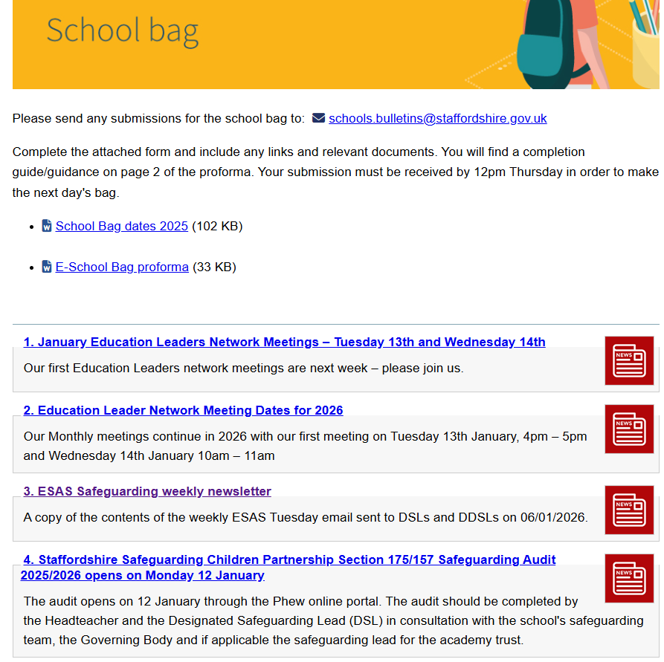
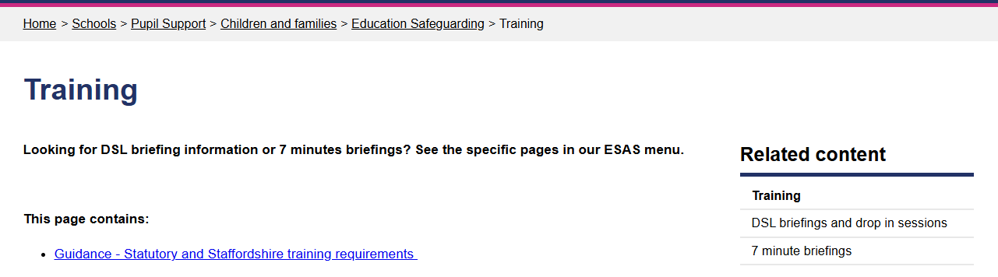
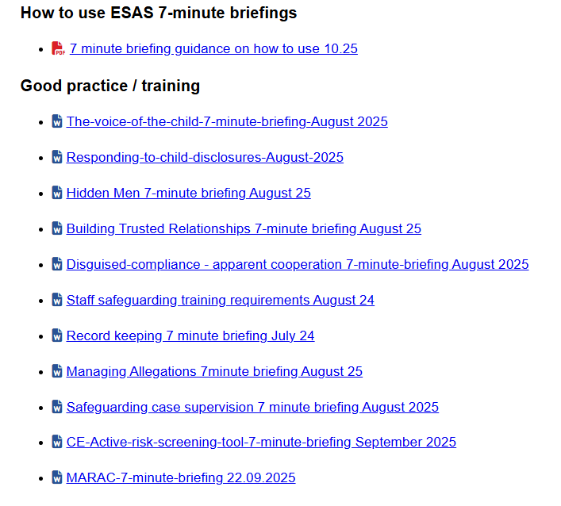
Education Safeguarding Advice Service (ESAS)
Resources
Notes:
Example of some of the detailed resources the team provides…
Weekly Tuesday email
Which is also publishe in the school bag
Lots of resources on the SLN
Including 7 minute briefings
ANY QUESTIONS

